Slide 1
New England Governors’ Renewable Energy Blueprint
New England States
Committee on Electricity
at the
Restructuring Roundtable
September 19, 2009

Slide 2
About NESCOE
New England’s Regional State Committee
Governed by a board of Managers appointed by each of the New England Governors
Focus on system planning & expansion and resource adequacy
More information at nescoe.com

Slide 3
The Blueprint’s Path
September 2008 NEGC Resolution
February 2009 Governors write to President Obama, Congressional leaders
March 2009 States request ISO-NE perform technical analysis
July 2009 ISO-NE issues draft Renewable Development Scenario Analysis
September 2009 NEGC Adopts Blueprint

Slide 4
Renewable Development Scenario Analysis
Background & Observations

Slide 5
Policy Choices Informed By Data
States asked ISO-NE to study “significant sources of renewable energy available to New England, the most effective means to integrate them into our power grid, and the estimated costs” and then developed study assumptions
ISO-NE conducted RDSA
Looks out 20 years
9 conceptual transmission scenarios
Focus on wind resources
Up to 12,000 MW of wind in New England
7,500 MW onshore & 4,500 MW offshore
Incremental cases from 2,000 to 8,000 MW

Slide 6
What the RDSA is Not
Not an effort to identify 2030 supply, demand levels
Not meant to discount contribution other low-carbon resources will make to New England
Not meant to signal any reduced interest in efficiency and demand reduction
Not an identification of preferred resource locations or preferred transmission pathways
Competitive markets or solicitations will determine what resources are developed, where, and by whom

Slide 7
New England has Options slide courtesy ISO-NE; refer also to RDSA, dated September 1, 2009, page 23
Description Partial list of scenarios | New Capacity (Megawatts) | Percent of New England Energy (%) | Preliminary Transmission Cost Estimates (Billions)
From New England:
4,000 MW of offshore wind plus 1,500 MW of inland wind | 5,500 MW | 12% | $6 B
12,000 MW of wind | 12,000 MW | 23% | $19 B to $25 B
From New England and Eastern Canada:
5,500 MW of wind (from above) plus 3,000 MW of additional imports from Québec and New Brunswick | 8,500 MW | 15% | $7 B to $12 B
12,000 MW of New England wind plus 3,000 MW of additional imports from Québec and New Brunswick | 15,000 MW | 26% | $17 B to $36 B

Slide 8
Historical Law & Policies Support Development
Each New England state has historically encouraged development of renewable resources in & outside state borders
clean energy grants, net metering rules,
renewable portfolio standards, etc.
Wind is eligible under all definitions of
renewable energy credits in current state
& proposed federal renewable portfolio
standards
Provides revenue stream from REC sales

Slide 9
Ample Resources, Choices
The New England region has a vast quantity of untapped renewable resources
more than 10,000 MW (nameplate) on & off-shore wind power potential
If developed at conservative levels, there are ample renewable resources to enable New England to meet renewable energy goals
More aggressive development could enable New England to export renewable power to neighboring regions

Slide 10
Transmission Options
Potential transmission projects can be identified to transfer power from off & on-shore wind resources to New England load & for export to our neighbors
Transmission costs vary with level of resource development
Expansion of near off-shore wind resources could be accomplished incrementally with lower-voltage, lower-cost interconnections directly into coastal load centers

Slide 11
Informed Choices
The level of renewable resources that will succeed in regional markets will be driven primarily by cost considerations, including transmission infrastructure and other development costs, as well as revenue opportunities that derive from federal & state policy mechanisms & incentives

Slide 12
Helping to Bring New, Cost-Effective, Renewable Resources to Market
Procurement and Contracting

Slide 13
Long-Term Contracting Authority
All six states have authority to approve long-term contracts for capacity, energy and/or renewable energy credits
Across New England, procurement
is generally executed through
competitive solicitations
Typically, competitive procurement
is implemented by utilities, subject to review & approval by Public Utility Commissions

Slide 14
Massachusetts’ Contracting Authority
DPU can approve long-term contracts of any duration or type if proposed by an EDC to meet basic service needs or to reduce the delivered price of power
New requirement for EDCs to solicit long-term contracts for the purchase of renewable power
EDCs can submit for DPU approval contracts of any duration to meet their RPS obligations
DPU has authority to approve long-term contracts proposed by EDC to meet future basic service needs

Slide 15
Contract Synchronization Opportunities
States generally have authority over contract term length
A majority have flexibility with respect to contracts with resources within or out of state
States with integrated resource planning have added flexibility to synchronize procurement with others
Common goal in each state’s contracting
authority relates to securing
low cost, cost-effective or cost-stabilizing power

Slide 16
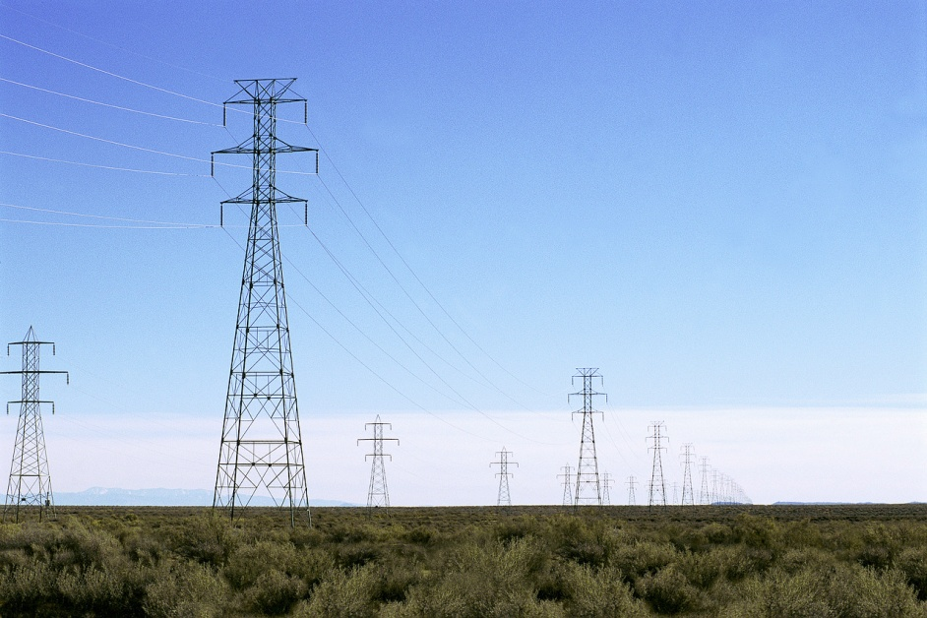
Helping to Bring New, Cost-Effective, Renewable Resources to Market
SitinG interstate Transmission

Slide 17
Siting Authority
All six states generally have exclusive siting authority
All six states have sufficient statutory flexibility to coordinate
Several states have specific & broad coordination authority

Slide 18
Massachusetts’ Coordination Authority
Massachusetts is authorized to:
Conduct joint investigations
Hold joint hearings in or outside of Massachusetts
Issue joint or concurrent orders with any other state
Function under compacts with other states in certain circumstances

Slide 19
Commonalities Create Opportunity
States’ siting review timelines sufficiently similar to enable some degree of simultaneous review
Common application elements
Common required findings
Timelines
Applications
Findings
Opportunity

Slide 20
Coordination Opportunities
Conduct approximately concurrent state siting reviews
Develop common component of the application
project description
maps
information on system impact
costs
testimony on facility need
Issue coordinated discovery on overall project, streamline responses

Slide 21
Further Coordination Opportunities
Hold joint hearing on issues relating to common findings
Local Processes Preserved: joint hearing not to displace local hearings on local matters
Consider adopting joint or concurrent orders on common required findings

Slide 22
State-Federal Partnership
State and federal officials working together will reinforce our ability to simultaneously advance our clean energy goals & the nation’s interest in reducing carbon emissions, diversifying energy supply and reducing reliance on foreign fossil fuel

Slide 23
Regional Processes Informing Federal Action
New England’s work to date will add considerable value to national planning dialogue
Federal administrative agency actions and/or any federal financial assistance should be linked to regional planning & scenario analyses and should:
Support New England’s plan to encourage development of renewable resources in the context of competitive market mechanisms or solicitations
Give priority to renewable resources indentified in regional processes

Slide 24
Conclusion
New England has the essential elements in place to help bring our cost-effective, secure, low-carbon resources to market
natural resources
technical analysis to inform policy choices
cooperative experience and authority to do more
statutory flexibility
mutual state and national interest in increasing renewable power

